Slide 1
Plate Tectonics Stations

Slide 2
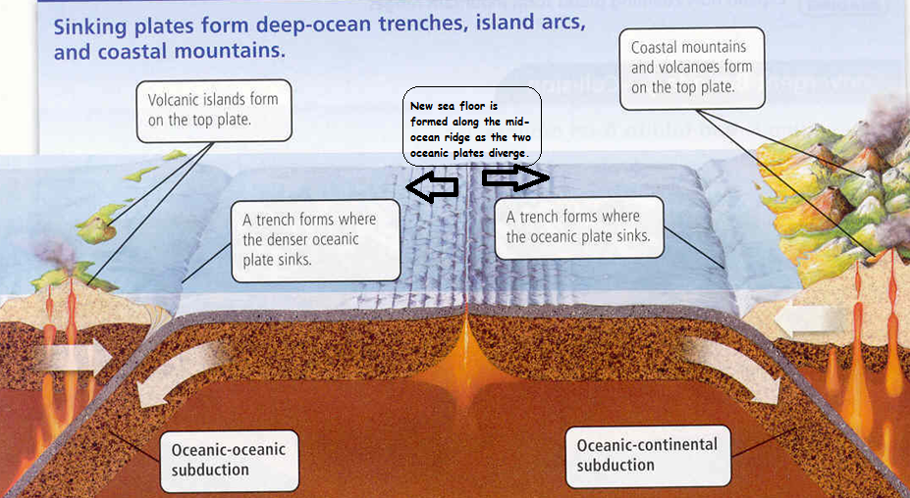
Study Station

Slide 3
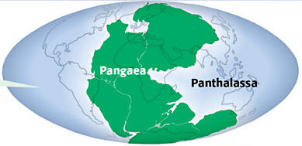
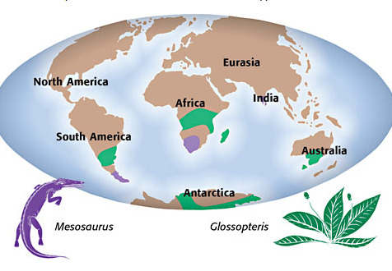
Station 1
____________theorized that continents are moving away from each other.
State the theory of Continental Drift.
3. What 3 evidences did he use to support his theory?

Slide 4
Station 2
Convection current is responsible for plate movements. Convection current can be found when you boil water, for example. As water gets warmed from the heating source, it rises, then cools again as it reaches top. Define convection current in your own words.
Write down the definition for ridge push:
Write down the definition for slab pull:
Draw a diagram that shows the
interaction between all three movements.

Slide 5
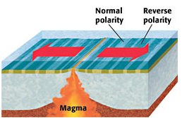
Station 3
_______theorized that sea floor is spreading along the mid-ocean ridge.
What evidence did he use to state that sea floor is spreading?
Describe sea-floor spreading.

Slide 6
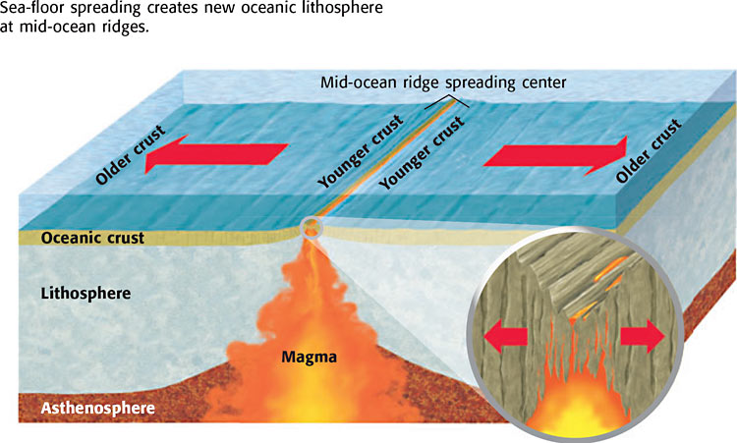
Station 4
1. How do the scientists know that the sea floor is spreading?
2. True or false? The crust is newer (younger) the further away you get from the mid-ocean ridge [If false, rewrite so that the statement true]
3. If two oceanic plates converge, which will subduct?

Slide 7
Station 5
1. There are two types of plates. They are called ____________and ______________.
2. _____________plate is less dense than ________plate.
3. If the two plates collide, _________plate will sink because it is ___________________.
4. Where the two plates meet and interact is called _____________.

Slide 8
Station 6
In divergent boundary, the plates _______ from each other.
2. Illustrate this type of boundary with arrows indicating direction.
3. When two oceanic plates diverge, __________is formed along mid-ocean ridge.
4. _______________is formed when the continental plate moves away from each other. The most famous one is called ______________(found in Africa) *STUDY STATION.

Slide 9
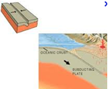
Station 7
When 2 plates move toward each other and collide, it is called ______________boundary.
Illustrate this type of boundary with arrows indicating direction.
When two plates collide, the two either ____________________ or _____________.

Slide 10
Station 8
When two oceanic plates move toward each other and collide, it is called _______-________ _________boundary.
At this boundary, _______________plate ____________under a younger, less denser plate.
______________and ___________ is formed at this boundary.
Famous examples of this type of boundary are *STUDY STATION
5. Illustrate this boundary with arrows and include landforms.

Slide 11
Station 9
When two continental plates move toward each other and collide, it is called _______-________ _________boundary.
2. At this boundary, neither plate is subducted. Instead, the plates ______________________.
3. ______________is formed at this boundary.
4. Famous example of this type of boundary is:
5. Illustrate this boundary with arrows and include landform

Slide 12
Station 10
When 1 oceanic and 1 continental plates collide, it forms_______-________ _________boundary.
At this boundary, ____________subducts under _____________.
______________ and _________are formed at this boundary.
Famous example of this type of boundary is:
5. Illustrate this boundary with arrows and include landform

Slide 13
Station 11
1. When two plates slide past one another horizontally, we call it___________boundary.
2. In this boundary, no new crust is created and no crust is subducted. Instead __________builds up.
3. When the built up energy is released, ___________ is created.
4. When layers of the earth is broken due to stress, it is called ___________.
5. Illustrate this boundary with arrows and include landform

Slide 14
Station 12
Compression is a type of stress that occurs when an object is squeezed. Write this definition in your own words.
Tension is a type of stress that occurs when forces act to stretch an object. Write this definition in your own words.
At which type of plate boundary would you find compression?
At which type of boundary would you find tension?

Slide 15
Station 13
When the rocks bend due to stress in the Earth’s crust, we call it folding. Draw what this may look like.
Uplift occurs when a part of the earth’s crust rises to higher elevation. At which type of boundary would you find uplift? What landform is created?
3. Subsidence occurs when a part of the earth sinks below its original elevation (but doesn’t subduct into asthenosphere). At which type of boundary would you find subsidence? What landform is created?

Slide 16
After the stations…(bonus points!)
*Come to this station ONLY after you’ve finished 1-13
What would happen if there were no convergent boundaries? (Only divergent or transform)?
What would happen if there were no divergent boundaries? (only convergent or transform?)
What would happen if the center of the earth cooled to the same temperature of the lithosphere?

