Slide 1
Do First
1. The process in the water cycle where water moves into the ground is called what?

Slide 2
Groundwater Notes

Slide 3
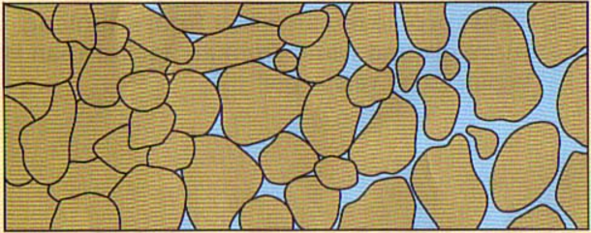
The Ground
The ground is split into two main parts:
1. Permeable Rock or Soil
Allows water to pass through it
2. Impermeable Rock
Does not allow water to pass through it
Circle the impermeable rock in the picture

Slide 4
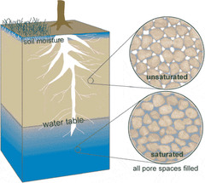
Permeable Rock or Soil
Permeable Rock and Soil is split into two regions
1. Zone of aeration
Where water passes through pores or cracks
2. Zone of saturation
Where water is held in pores or cracks
Where the two zones meet is called the water table
Label the two zones in the picture

Slide 5
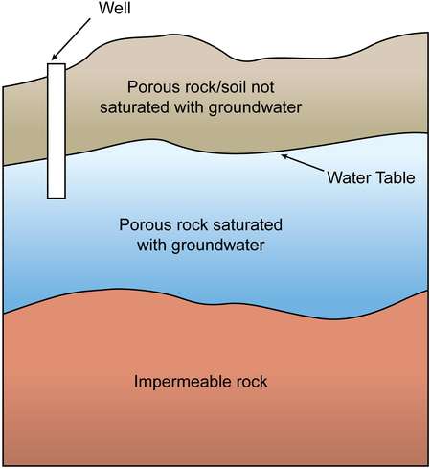
Zone of Saturation
All the water held in the zone of saturation is called groundwater
The rock or soil that holds the water in the zone of saturation is called an aquifer
Why does water stay in the zone of saturation?
Because there is impermeable rock below the zone therefore the water cannot move further down
Impermeable rock found in the zone of aeration is called an aquitard
Label the aquifer and the two zones in the picture

Slide 6
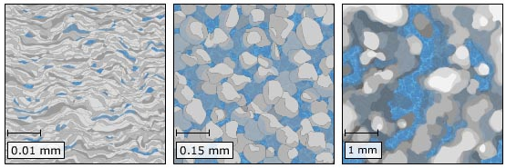
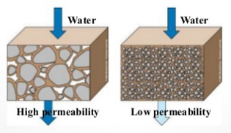
Water Movement
The movement of water into the ground is called ________________
Water moves into the ground due to gravity
The amount of water that can move and stay in the ground depends upon two factors of the rock or soil:
Porosity
The percentage of pore spaces
Determines how much groundwater can be stored
Permeability
Ability to transmit water through connected pore spaces

Slide 7
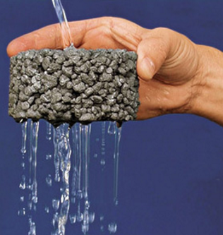
Porosity and Permeability
It’s not the number of pores but the size of the pores that determine whether a soil has high permeability

Slide 8
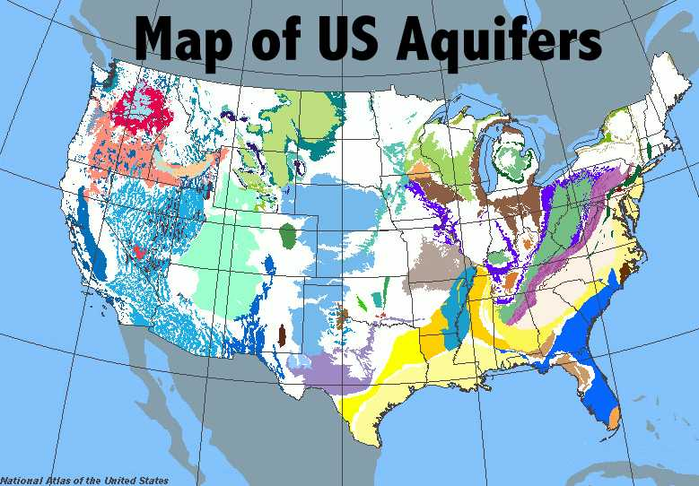
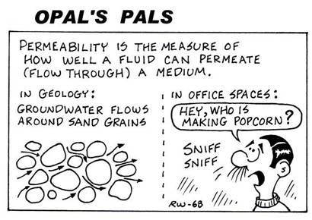
Aquifers
Aquifers are a source of freshwater
The water held in aquifers is being used faster then the rate of replenishment

Slide 9
Underground to Aboveground
Features that can cause water from underground to come aboveground are:
Springs (natural)
Wells (man made)

Slide 10
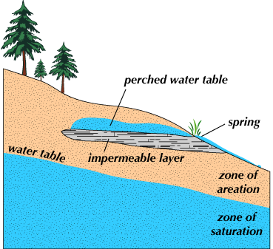
Springs
A spring forms whenever the water table intersects the ground surface.
Hot springs release warm water that has been heated by the cooling of igneous rock
A geyser is a hot spring that periodically releases water and steam
Water turns into steam underground creating pressure and causing an eruption

Slide 11
Geyser
Most famous geyser in the US is “Old Faithful” in Yellowstone National Park
https://www.youtube.com/watch?v=Qxf3xzirBrs

Slide 13
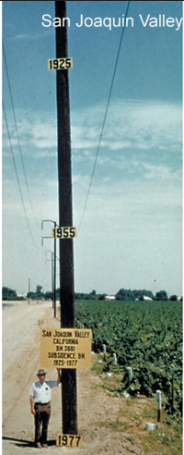
Well
A well is a hole bored into the zone of saturation
An artesian well is a when groundwater rises due to pressure
Positive impact of a well
Access to freshwater
Negative impacts of a well
Lowering of the water table due to removal of water
Possible formation of cone of depression

Slide 14
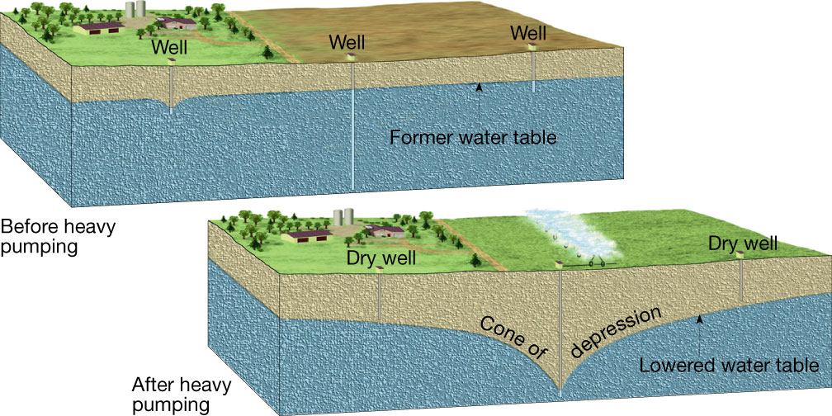

Slide 15
Caverns
Caverns are underground caves that are formed near the water table due to erosion
Calcite dripping into the cave can form unique features in the cave depending upon how the calcite hardens
Stalactites – hanging from the ceiling
Stalagmites – growing upward from the floor
Columns – when stalactites and stalagmites meet
When caverns collapse they cause sinkholes on the surface of the Earth

Slide 16
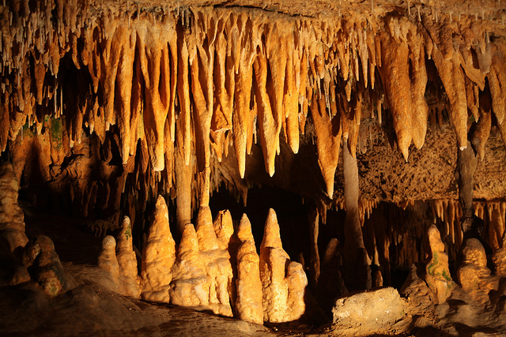
Cavern features

Slide 17
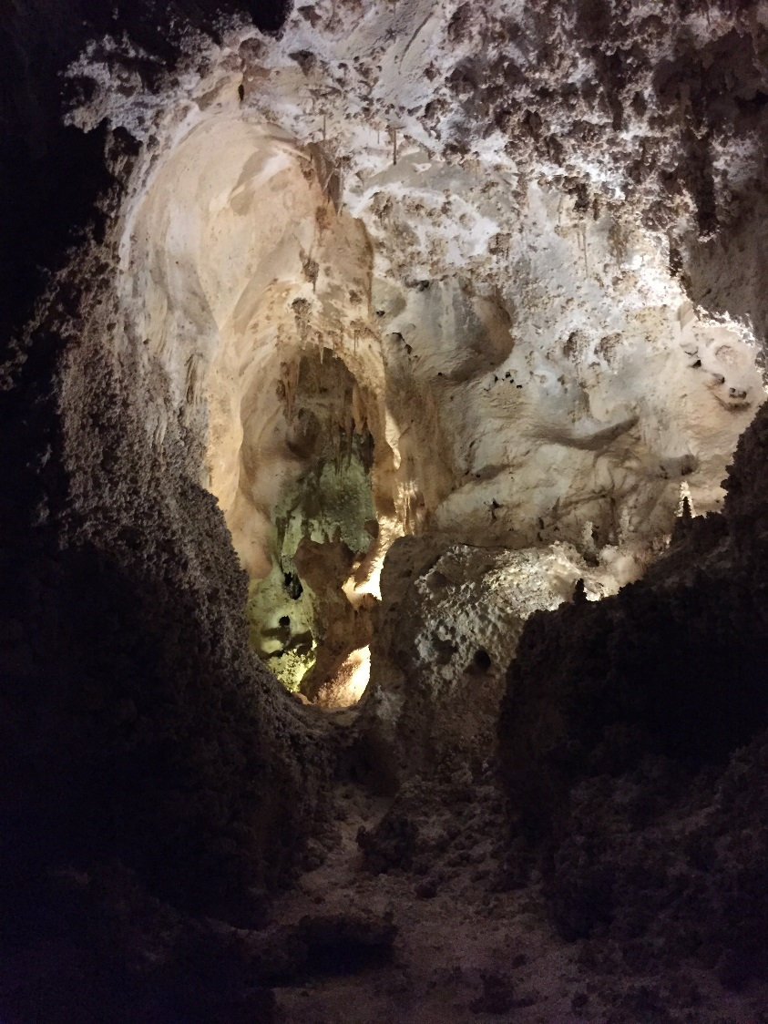
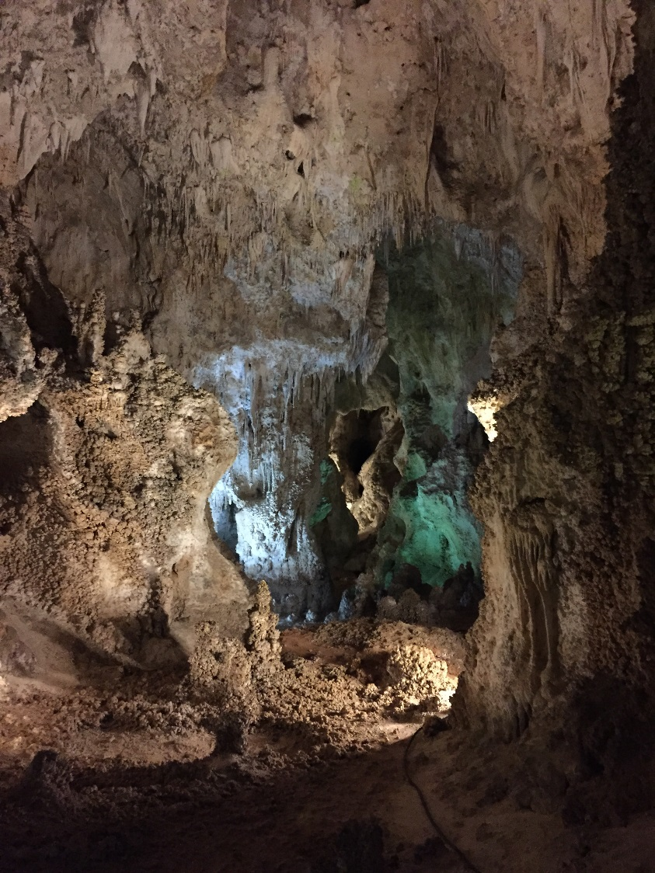
Carlsbad Caverns

Slide 18
https://www.youtube.com/watch?v=ob9WFa6FGDo

Slide 19
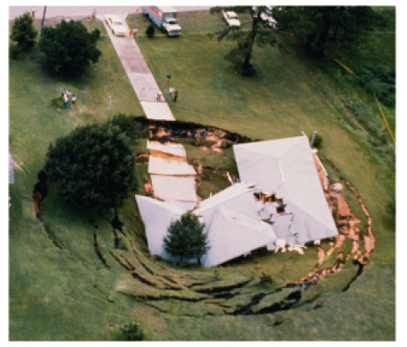
Sinkhole

Slide 20
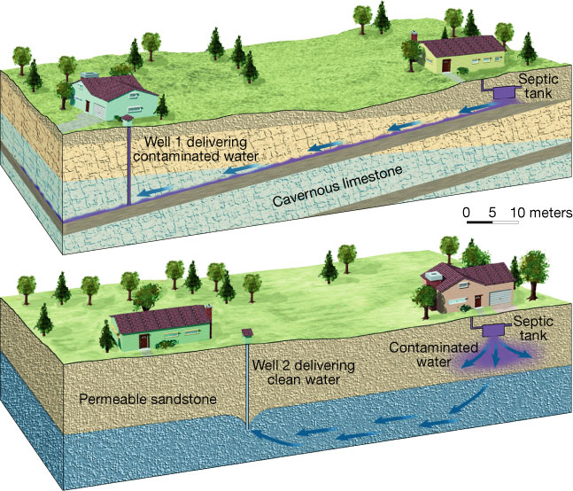
Environmental Concerns
There are three huge concerns regarding groundwater
The loss of groundwater due increased use and decreased replenishment
The contamination of groundwater from human activity
Surface structure impact due to loss of water support below ground

Slide 21
DYL
1. Name the two main areas that the underground is split into?
2. What is the boundary between the zone of aeration and the zone of saturation called?

Slide 22
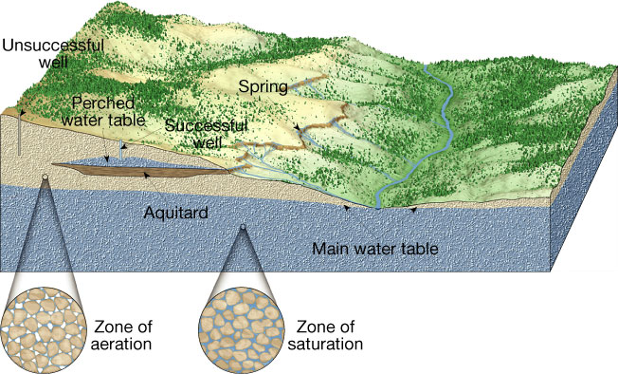
Geyser

